Slide 1
Financial Crisis 2008

Slide 2
The financial crisis of 2007–2008, also known as the global financial crisis and the 2008 financial crisis, is considered by many economists to have been the worst financial crisis since the Great Depression of the 1930s.
Housing Bubble Formation = Lending Decision by Financial institutions + Borrowing Decision by individuals.

Slide 3
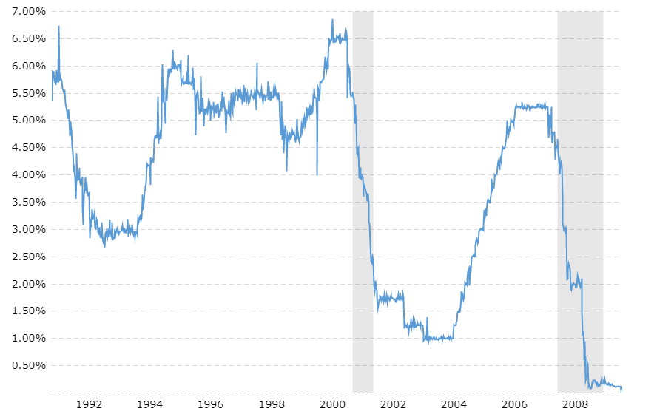
FED Interest rates
The Federal Reserve Board (FED) manages the nation’s monetary policy by controlling money flow in system & try to maintain stable economy.

Slide 4
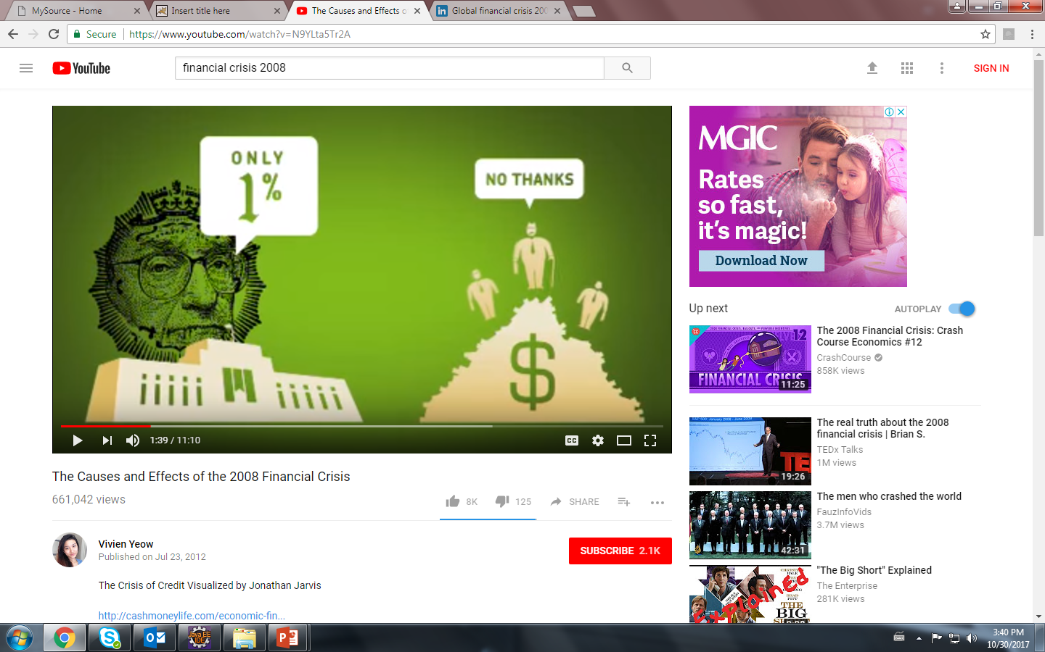
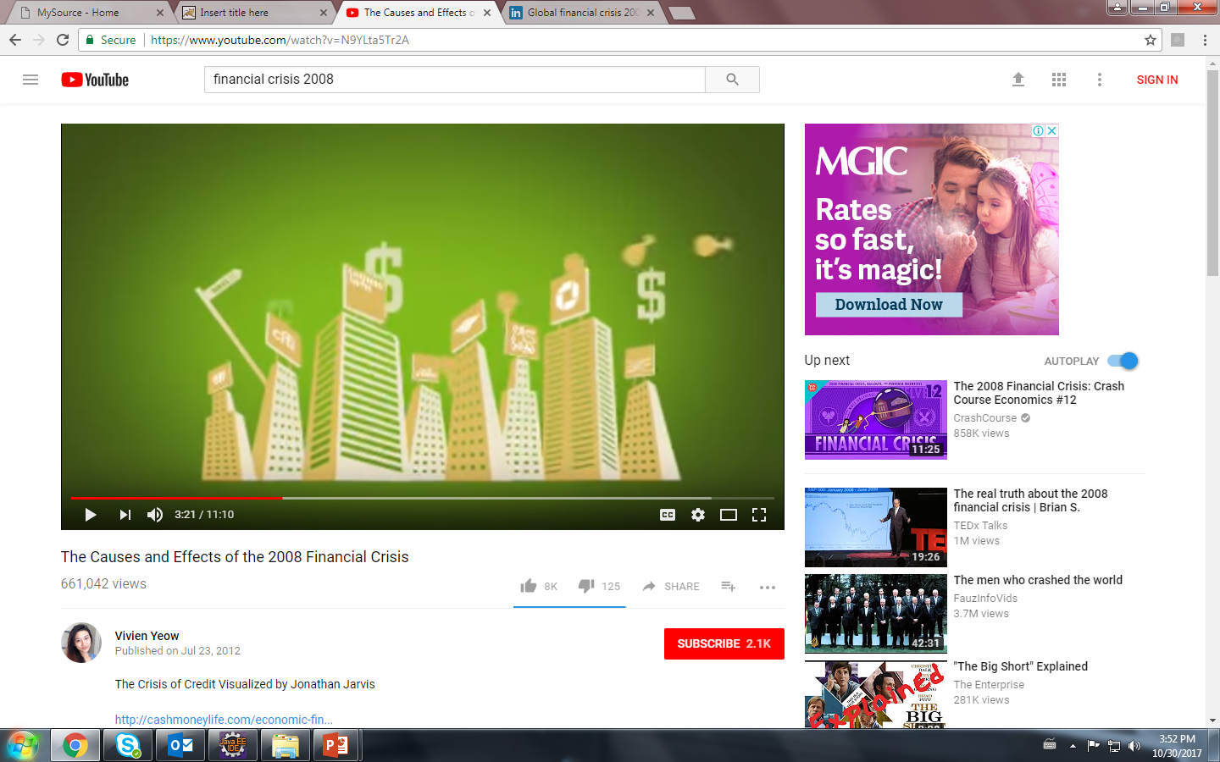
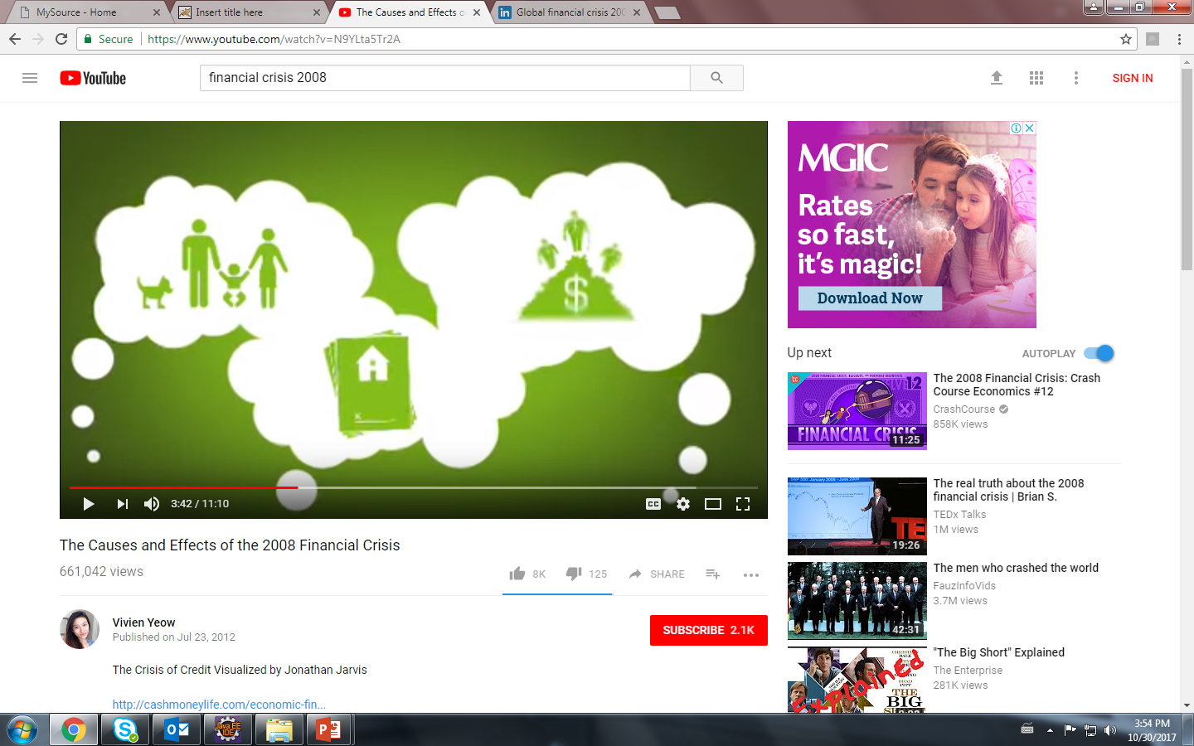

Slide 5
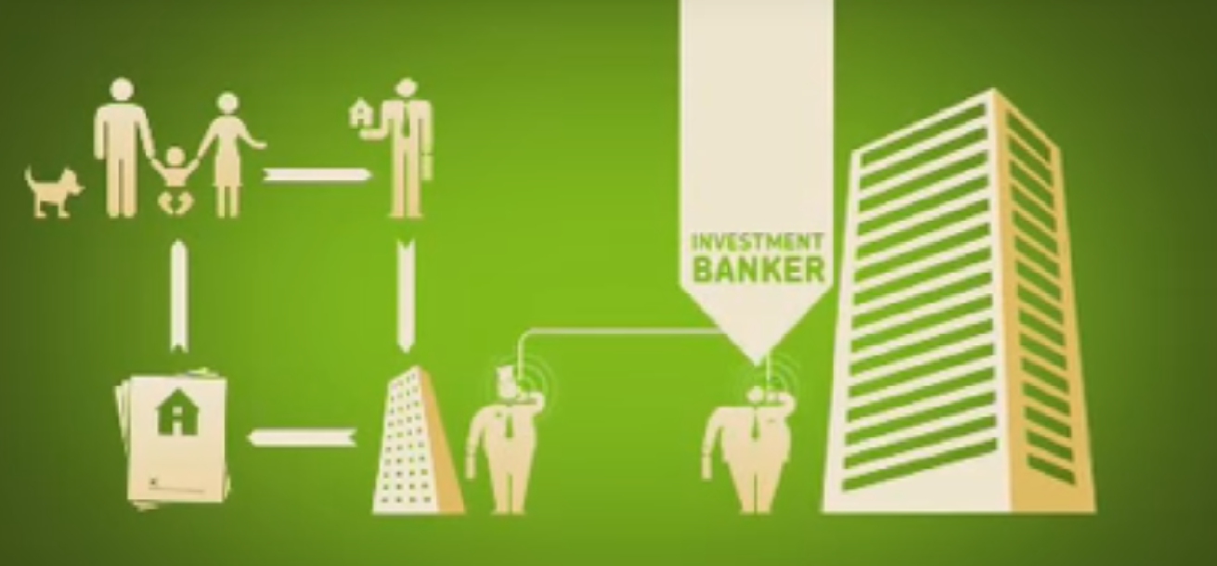
Mortgage home

Slide 6
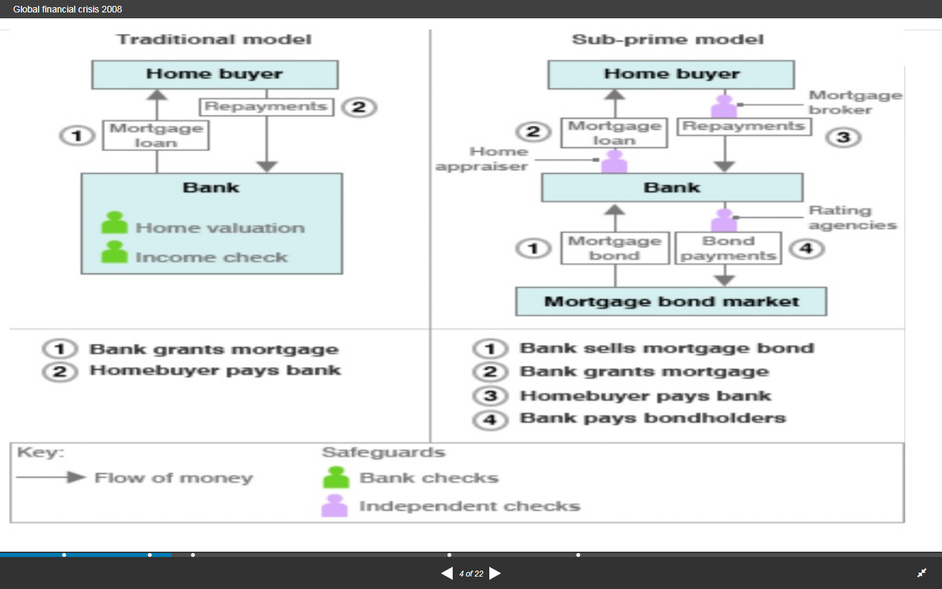

Slide 7
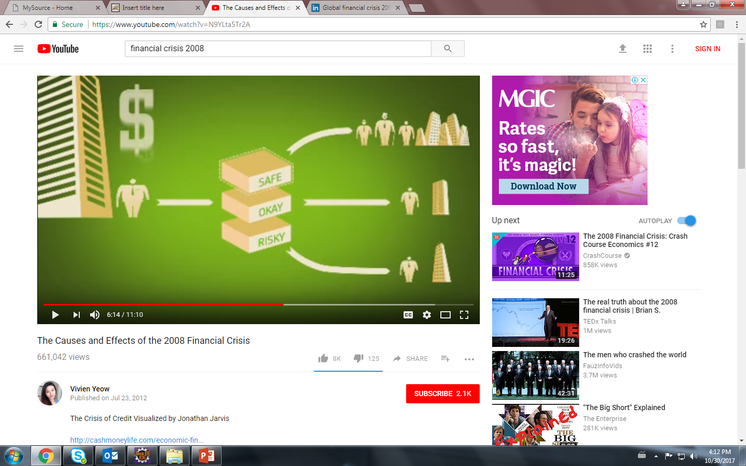
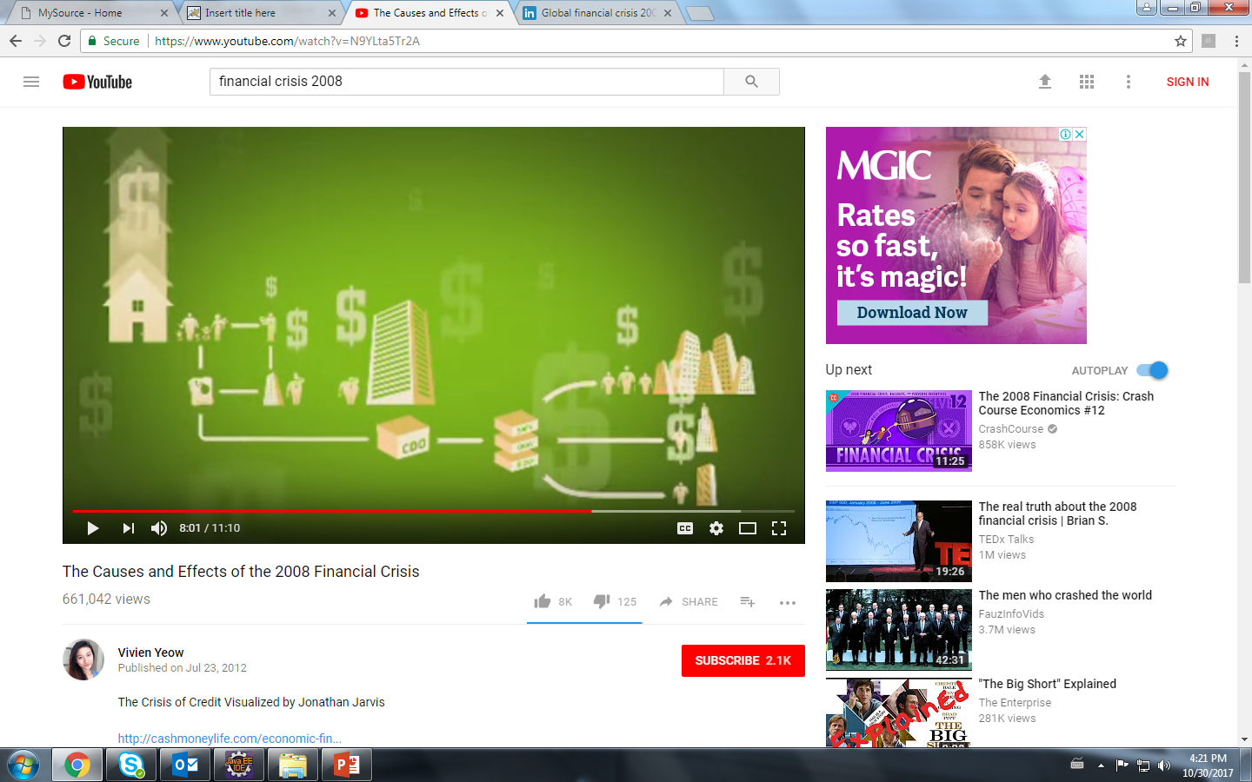
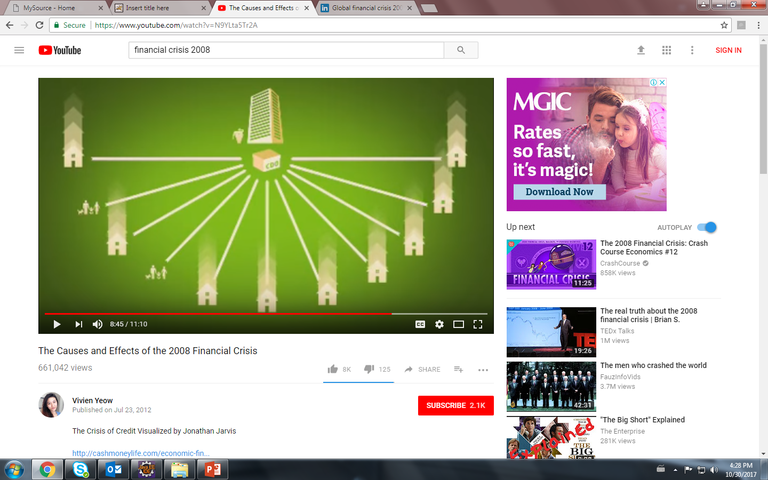
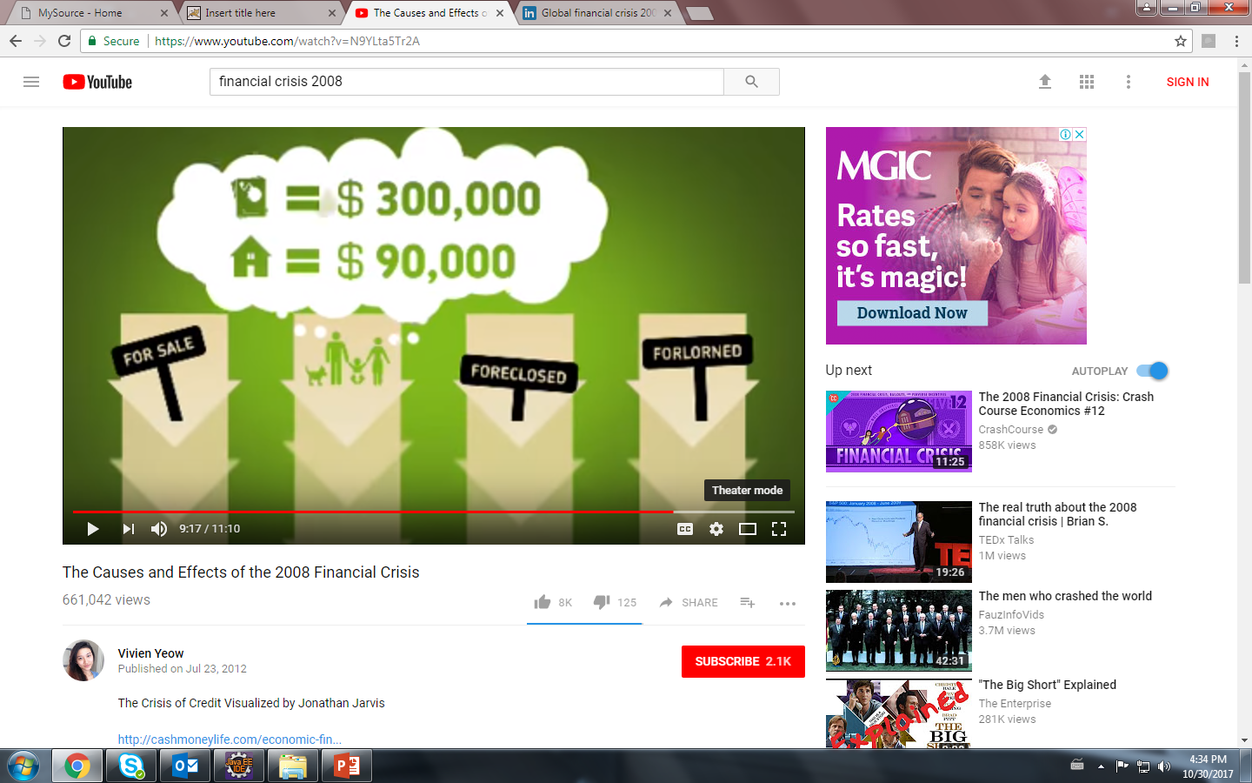

Slide 8
Causes of Crisis
Relaxation in lending regulations
Poor creditworthiness of borrowers
Rising EMI due to higher interest cost
Borrowers unable to pay
Failure of banks and financial institutions

Slide 9
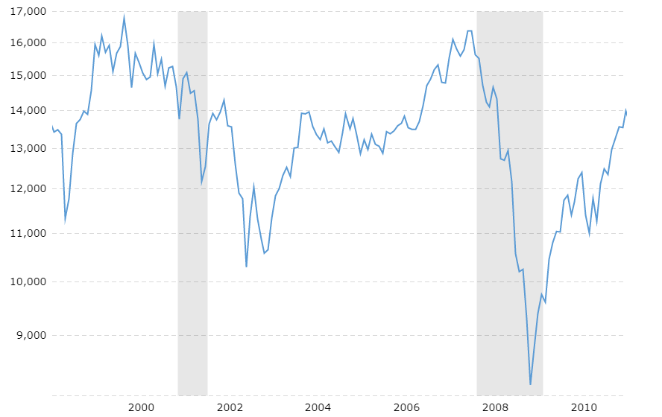
Dow Jones Price Change

Slide 10
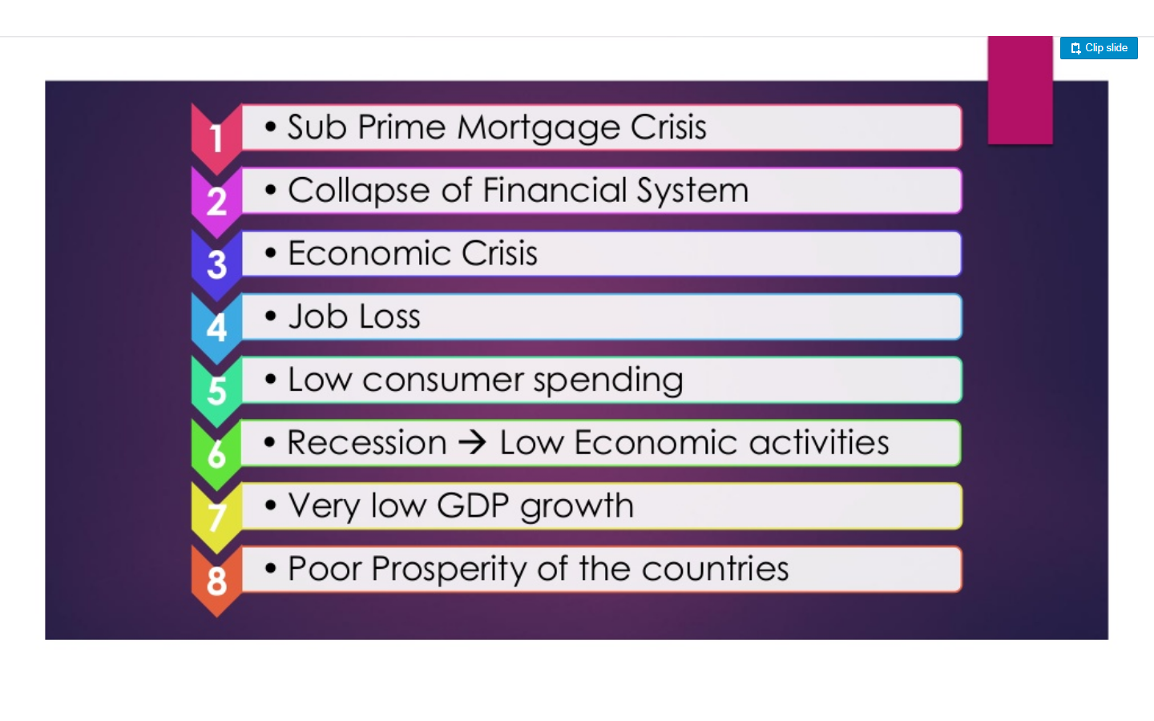
Impacts Of Crisis

Slide 11
Impacts on Financial Institutions
Major banks suffered from huge losses
Lehman brothers went out of business
Merrill Lynch had to sell itself to bank of America for a fraction of its former value
Countrywide Financial Corporation, the biggest U.S. mortgage lender, eventually gets taken over by Bank of America
In September 2008, AIG collapses as could not afford to pay all of these US mortgage defaults. The U.S. government nationalizes AIG by becoming 80 percent shareholder.

Slide 12
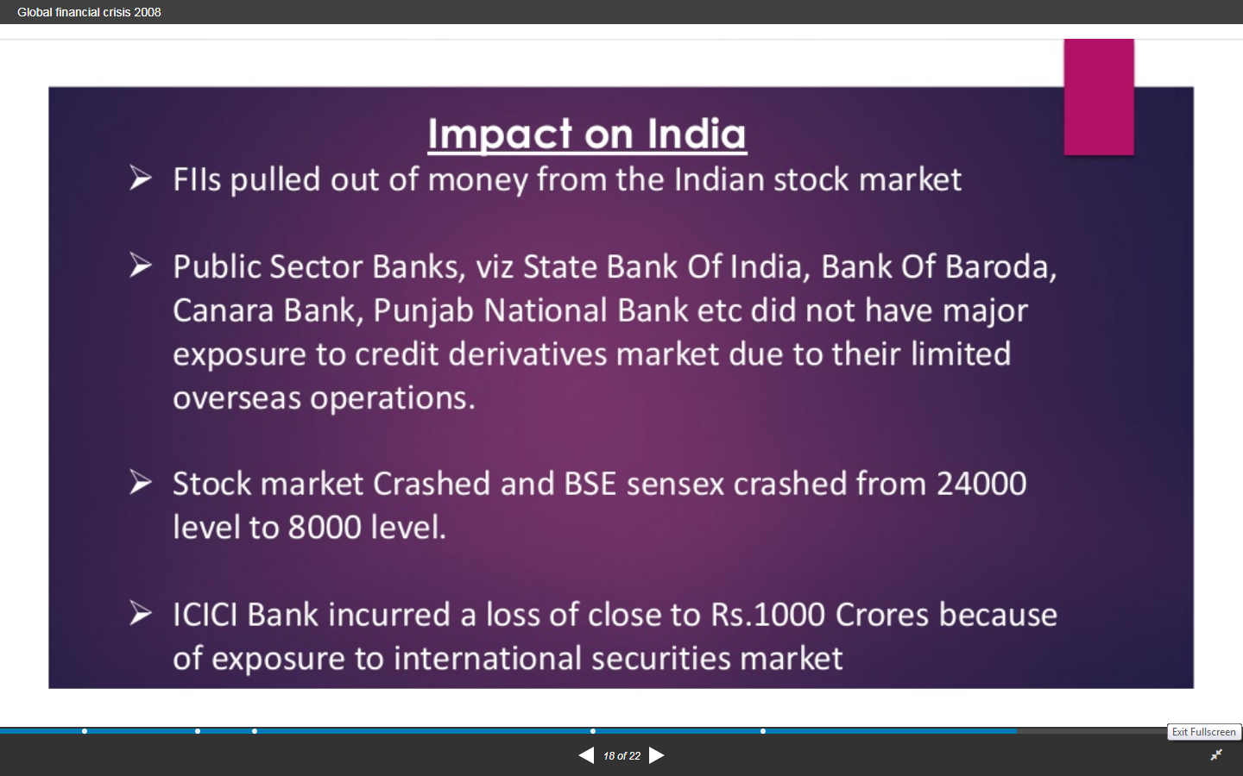
Impact on India

Slide 13
Thank You!

